Slide 1
Building and Scaling
A Functional Test Automation
Strategy
Workbook
Notes:
Introduction: 15 minutes
Building Your Strategy: 20 minutes
Break down tests: 1 hour
Building to Scale: 20 minutes
Wrap up: 5 minutes

Slide 2
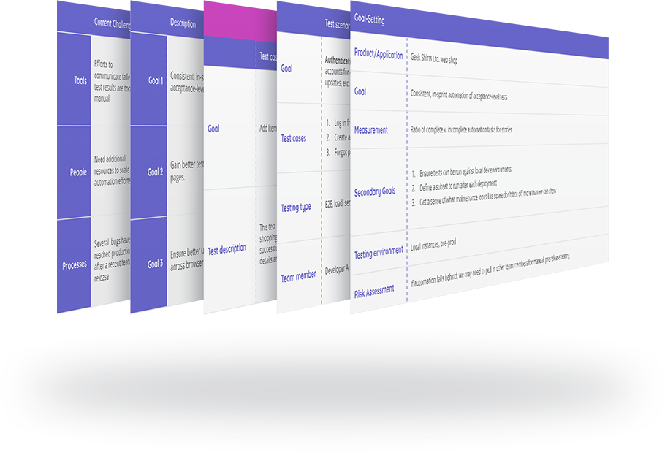
How to use this workbook
Starting - and Scaling - Functional Test Automation to Keep up with Fast-Paced Delivery
When starting or scaling your test automation efforts, you’ll be most successful by taking a step back and thinking strategically about your approach before you dive in and begin creating automated tests.
This workbook is meant to complement the live workshop, and can be used to help frame up your own test automation strategy.

Slide 3
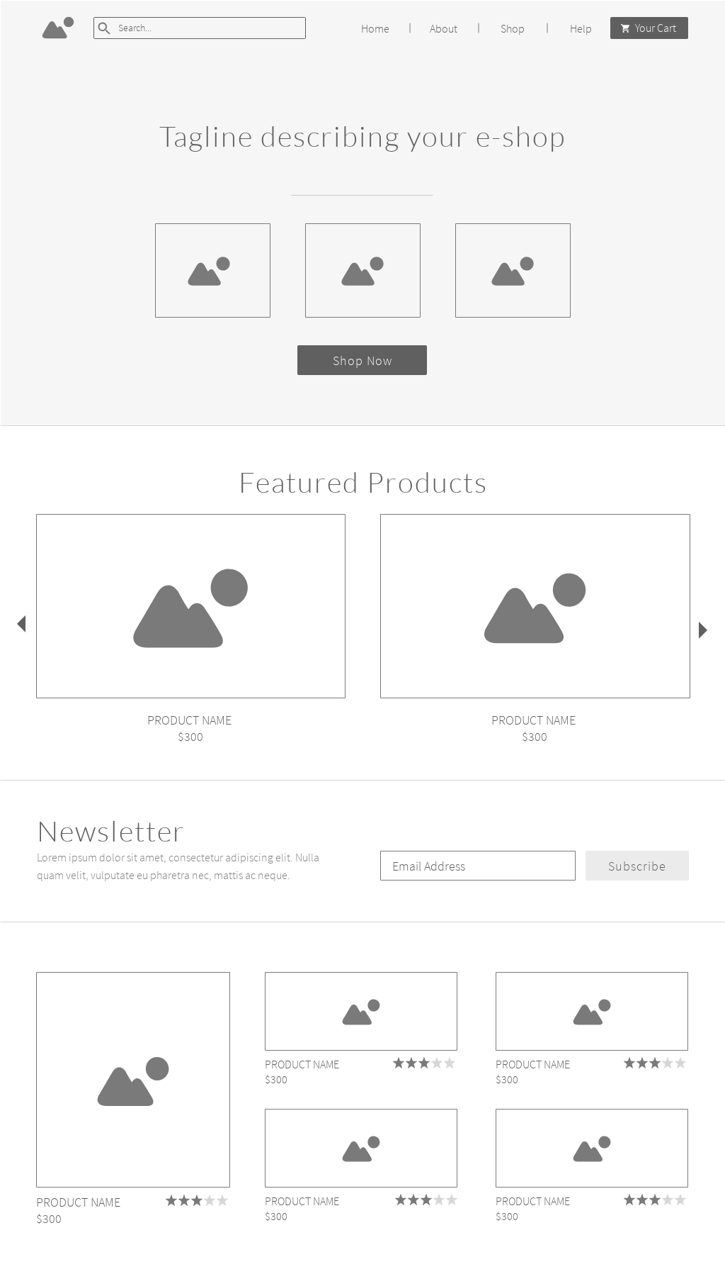
Our sample application
This is the app we’re ‘testing’ in as an example in this workbook
Testing a retail and ecommerce website
This is a greenfield project
We are the quality engineering team
There are APIs at our disposal
App devs do the unit, API and integration testing

Slide 4
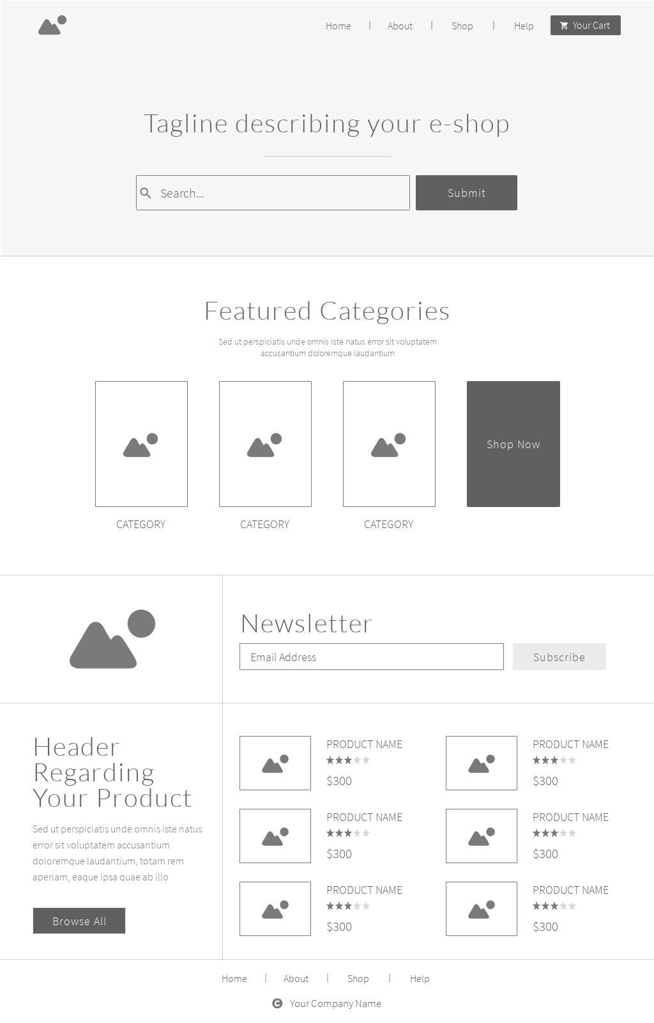
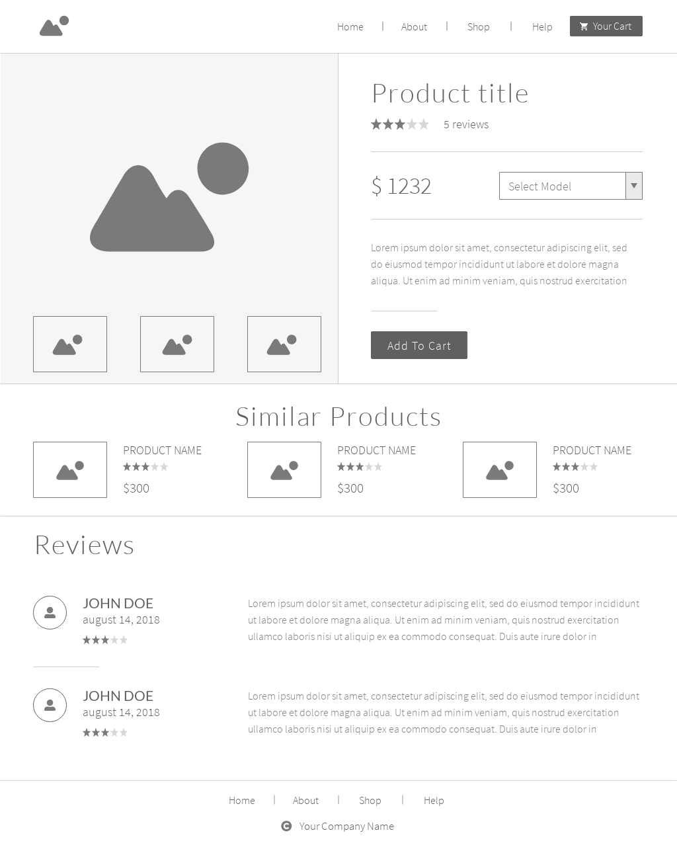
Our sample application
This is the app we’re ‘testing’ in as an example in this workbook

Slide 5
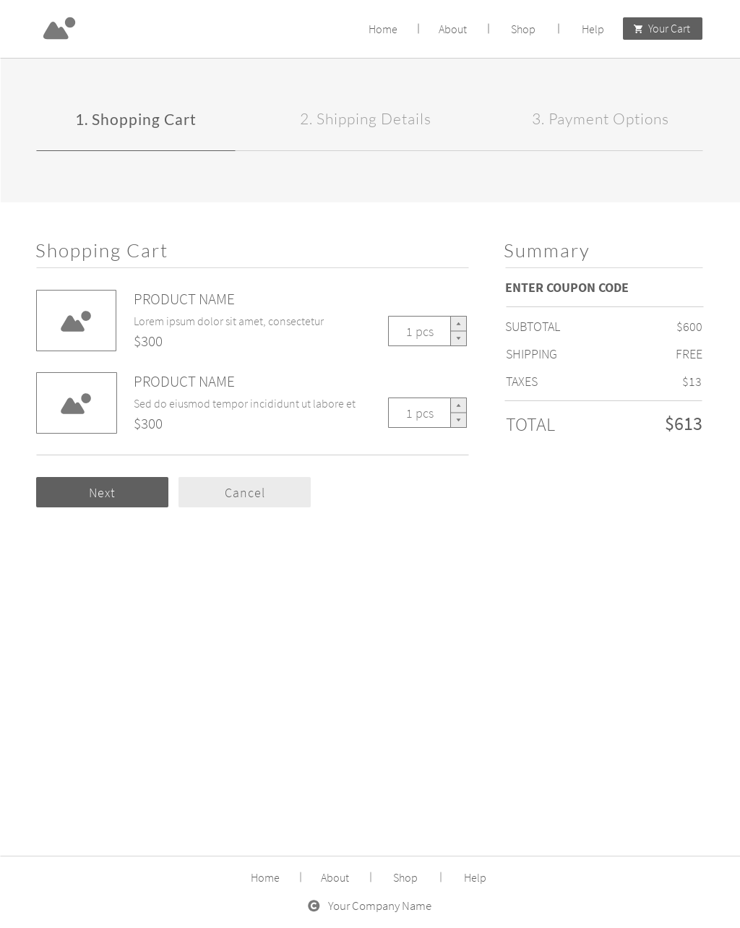
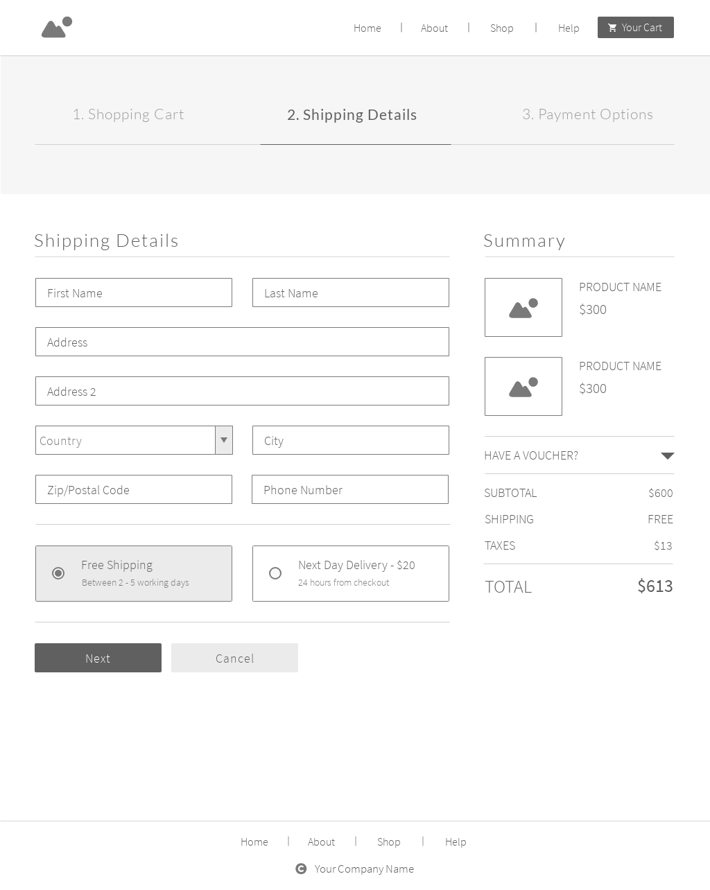
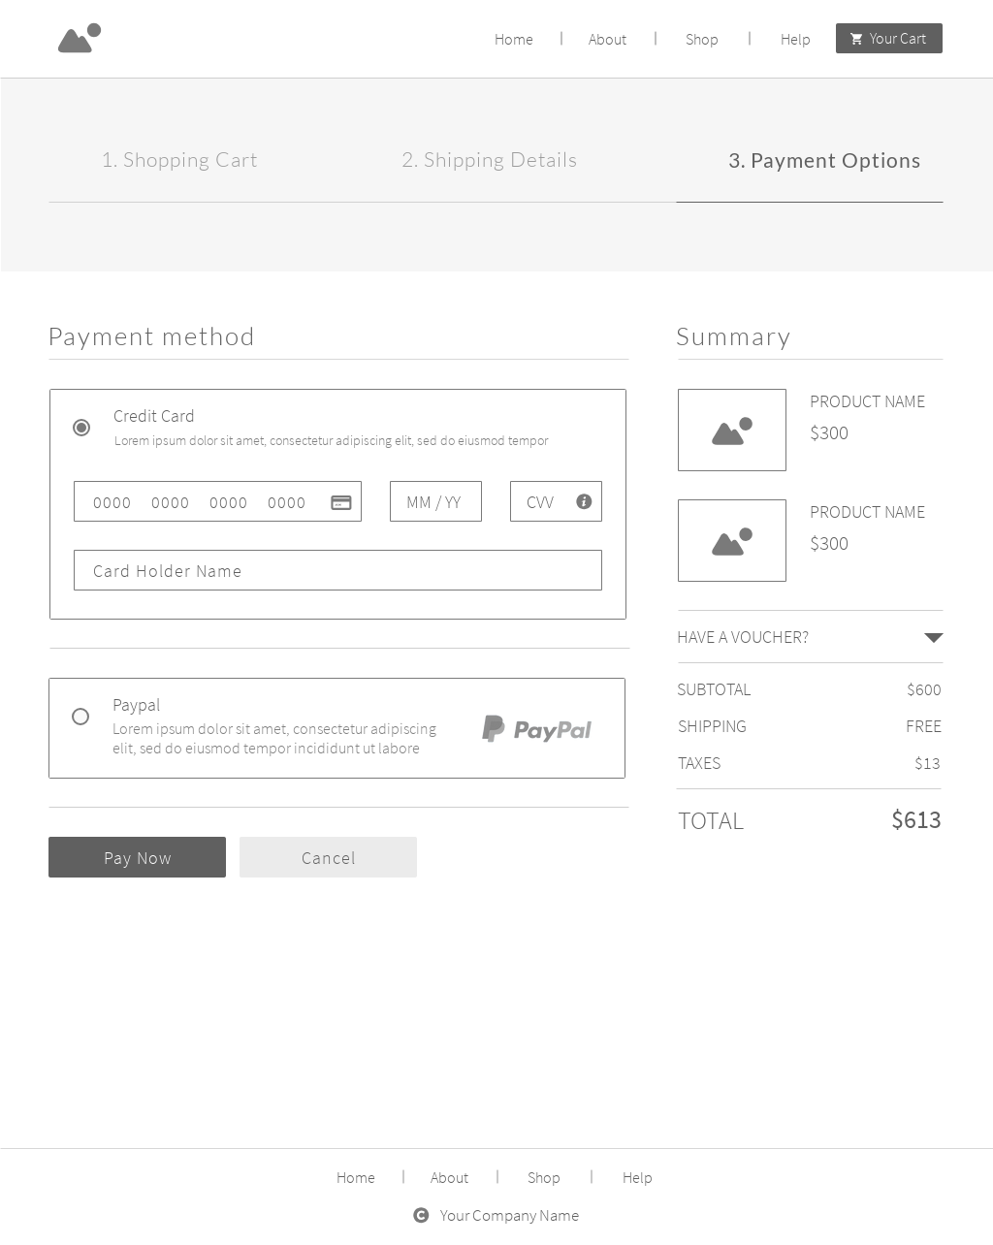
Our sample application
This is the app we’re ‘testing’ in as an example in this workbook

Slide 6
Setting goals
Sample worksheet
Goal-Setting
Product/Application | Geek Shirts Ltd. web shop
Goal | Consistent, in-sprint automation of acceptance-level tests
Measurement | Ratio of complete v. incomplete automation tasks for stories
Secondary Goals | Ensure tests can be run against local dev environments Define a subset to run after each deployment Get a sense of what maintenance looks like so we don't bite off more than we can chew
Testing environment | Local instances, pre-prod
Risk Assessment | If automation falls behind, we may need to pull in other team members for manual, pre-release testing
Notes:
That was a great discussion. For our purposes today, I filled in this worksheet and set one of our goals. Since we’re just getting started with automation here, I set our goal as setting consistent, in-sprint automation of acceptance-level tests. [review any highlights in the worksheet that might be useful]
This goal, along with the ones we developed together will be our guiding star throughout the workshop.

Slide 7
Setting goals
Your turn - fill in this worksheet
You may have multiple goals! Complete one worksheet for each goal.
Goal-Setting
Product/Application | Product ABC
Goal | Describe your primary goal for testing.
Measurement | Describe how this goal will be measured.
Secondary Goals | Describe 2-3 secondary or sub-goals that will help you reach your primary goal. It’s helpful to break big goals down into manageable parts. Try to assign metrics to each of these!
Testing environment | Describe the test environments you need (or have implemented), and the team members involved, to achieve this goal.
Risk Assessment | List the risks associated with this goal.
Notes:
Now that we’ve introduced an application - we can do anything. We created this worksheet (and you’ll see several of these during today’s session) to provide a framework for developing your goals. It’s important to not only define your goal, but make it measurable. Hopefully this is useful to you when you start to think about automation strategy.

Slide 8
Planning your test approach
Sample worksheet
 | Test scenario 1 | Test scenario 2 | Test scenario 3
Goal | Authentication. Users need to access their accounts for order information, shipping updates, etc. | Shopping cart. The ability for users to edit their cart is critical to get them to the checkout cart. | Checkout cart. This is critical to our app revenues. Without the checkout, there are no sales!
Test cases | Log in from the account link Create a new account Forgot password | Add an item Update a quantity Delete an item | Validate shipping information Select a payment method Verify a coupon code
Testing type | E2E, load, security, etc. | Performance, functional, etc. | Security, functional, E2E, etc.
Team member | Developer A, Tester A | Tester B | Developer B, Tester C
Starting - and Scaling - Functional Test Automation to Keep up with Fast-Paced Delivery • mabl

Slide 9
Planning your test approach
Your turn - fill in this worksheet
 | Test scenario 1 | Test scenario 2 | Test scenario 3
Goal | Test Scenario name. Describe the test scenario. | Test Scenario name. Describe the test scenario. | Test Scenario name. Describe the test scenario.
Test cases | Name a test case Name a test case Name a test case | Name a test case Name a test case Name a test case | Name a test case Name a test case Name a test case
Testing type | Describe the test type required | Describe the test type required | Describe the test type required
Team member | Name team(s) or team member(s) responsible | Name team(s) or team member(s) responsible | Name team(s) or team member(s) responsible
Starting - and Scaling - Functional Test Automation to Keep up with Fast-Paced Delivery • mabl

Slide 10
Planning your test cases
Sample worksheet
You may have multiple scenarios! Complete one worksheet for each, or scale the test cases as needed..
SCENARIO 1 - MANAGE SHOPPING CART
 | Add items to shopping cart | Update quantity in shopping cart | Remove existing item from cart
Goal | Allow users to add in-stock items to their shopping cart | Allow users to adjust quantity of items while in the shopping cart | Allow user to delete items from their shopping cart
Test description | This test will select and add items to shopping cart, confirm chosen items are successfully added to cart, and verify cart details and totals reflect accurately. | This test will update quantity total on existing items in the shopping cart, and validate that the quantities and updated cart totals are reflected accordingly. User will see an error if there is not enough inventory. | This test will select and delete items in shopping cart, confirm chosen items are successfully removed. Then, verify cart details and totals are reflected accurately.
Starting - and Scaling - Functional Test Automation to Keep up with Fast-Paced Delivery • mabl

Slide 11
Planning your test cases
Your turn - fill in this worksheet
You may have multiple scenarios! Complete one worksheet for each, or scale the test cases as needed..
SCENARIO 1 - MANAGE SHOPPING CART
 | Test case 1 | Test case 2 | Test case 3
Goal | What is the goal of this test case | Update Item quantity in shopping cart | Remove existing item from shopping cart
Test description | Describe how you would test this case. | Describe how you would test this case. | Describe how you would test this case.
Starting - and Scaling - Functional Test Automation to Keep up with Fast-Paced Delivery • mabl

Slide 12
Map future testing priorities
Sample worksheet
 | Description | Results | Next steps
Goal 1 | Consistent, in-sprint automation of acceptance-level tests | Ratio of complete v. incomplete automation tasks was at 50% | We’d like to achieve 70%. More staff is needed to support this area of the application. We need to: Train new staff members Identify code to target for automation of acceptance-level tests
Goal 2 | Gain better test coverage on product pages. | Increase test coverage by 20%. | Understand which product pages have the most traffic. Determine a realistic number of pages to build tests on. Define the test cases.
Goal 3 | Ensure better users experience across browsers and devices. | Increase pages/session the average users views by 2 pages. | Understand the most common browsers or operating systems our users are visiting our website on. Start with the top three.
Starting - and Scaling - Functional Test Automation to Keep up with Fast-Paced Delivery • mabl

Slide 13
Map future testing priorities
Your turn - fill in this worksheet
 | Description | Results | Next steps
Goal 1 | After automating business-critical test scenarios, describe what you will do next. | Describe the expected outcome. | Describe the steps you need to take to achieve your goal.
Goal 2 | After automating business-critical test scenarios, describe what you will do next. | Describe the expected outcome. | Describe the steps you need to take to achieve your goal.
Goal 3 | After automating business-critical test scenarios, describe what you will do next. | Describe the expected outcome. | Describe the steps you need to take to achieve your goal.
Starting - and Scaling - Functional Test Automation to Keep up with Fast-Paced Delivery • mabl

Slide 14





Intelligent test automation for Agile teams
Learn more at mabl.com
Increase Test Coverage: Create and manage tests for the entire user journey in a single platform.
Build Reliable Tests: As your application evolves, tests auto-heal along with it.
Test at the Speed of Development: Anyone can build and maintain tests in minutes, not days.
Integrated into Your Workflow: Integrate testing natively with popular CI/CD, issue tracking, and collaboration platforms.
Notes:
Mabl is an intelligent test automation platform built for Agile teams
Increase Test Coverage: Create and manage tests for the entire user journey, including API and browser tests, in a single platform.
Build Reliable Tests: As your application evolves, mabl improves reliability by auto-healing tests along with it.
Test at the Speed of Development: With low-code test automation, anyone can build and maintain tests in minutes, not days.
Integrated into Your Workflow: Integrate testing throughout your pipeline with native integrations with popular CI/CD, issue tracking, and collaboration platforms.

